Slide 1
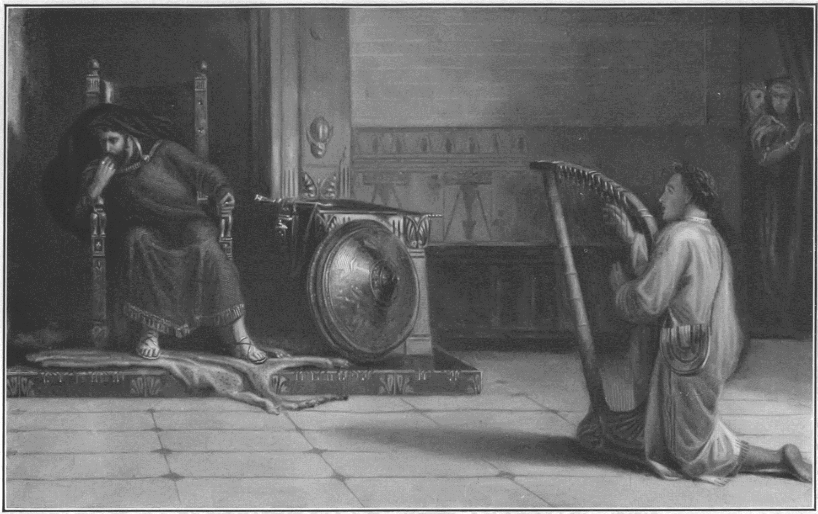
PERSECUTION
1 Samuel 18:1-11

Slide 2
David’s Promotion

Slide 3
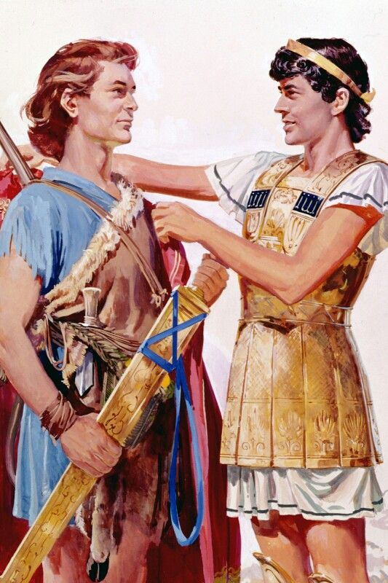
Jonathan’s Submission.
Jonathan saw David’s submission to the king.
Jonathan was also a man of faith and courage.

Slide 4
1 Samuel 14:6 And Jonathan said to the young man that bare his armour, Come, and let us go over unto the garrison of these uncircumcised: it may be that the LORD will work for us: for there is no restraint to the LORD to save by many or by few.

Slide 5
1 Samuel 14:14-15 And that first slaughter, which Jonathan and his armourbearer made, was about twenty men, within as it were an half acre of land, which a yoke of oxen might plow. 15 And there was trembling in the host, in the field, and among all the people: the garrison, and the spoilers, they also trembled, and the earth quaked: so it was a very great trembling.

Slide 6
2 Corinthians 10:12 For we dare not make ourselves of the number, or compare ourselves with some that commend themselves: but they measuring themselves by themselves, and comparing themselves among themselves, are not wise.

Slide 7
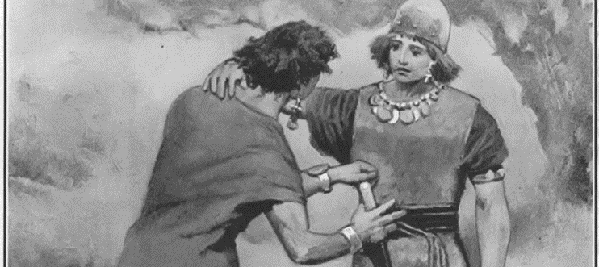
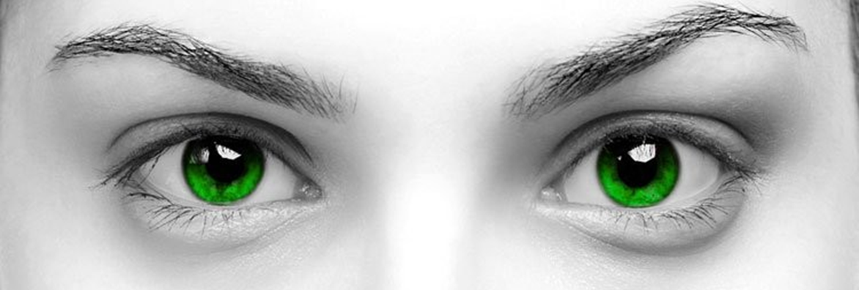
Jonathan’s Submission.
Jonathan saw David’s submission to the king.
Jonathan was also a man of faith and courage.
Pride makes us draw comparisons.
It results in envy.

Slide 8
Colossians 2:2 That their hearts might be comforted, being knit together in love, and unto all riches of the full assurance of understanding, to the acknowledgement of the mystery of God, and of the Father, and of Christ;

Slide 9
Jonathan’s Submission.
Who loved who as his own soul? Vs 1 and 3.
Jonathan submits to David.
Who is David a type of? Christ. Christ must reign.

Slide 10
Philippians 2:2-3 Fulfil ye my joy, that ye be likeminded, having the same love, being of one accord, of one mind. 3 Let nothing be done through strife or vainglory; but in lowliness of mind let each esteem other better than themselves.

Slide 11
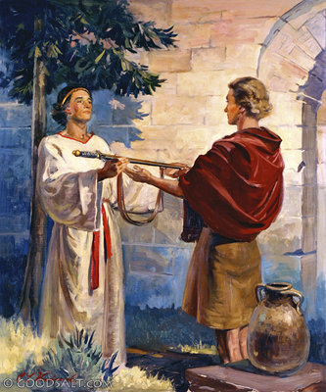
Notice the wisdom Jonathon has to BE a friend first.

Slide 12
Proverbs 18:24a A man that hath friends must shew himself friendly:
Proverbs 18:24b …and there is a friend that sticketh closer than a brother.
Proverbs 17:17 A friend loveth at all times, and a brother is born for adversity.

Slide 13
David’s Wisdom.
Be WISE!
Ephesians 5:17-21 Wherefore be ye not unwise, but understanding what the will of the Lord is. 18 And be not drunk with wine, wherein is excess; but be filled with the Spirit; 19 Speaking to yourselves in psalms and hymns and spiritual songs, singing and making melody in your heart to the Lord; 20 Giving thanks always for all things unto God and the Father in the name of our Lord Jesus Christ; 21 Submitting yourselves one to another in the fear of God.

Slide 14
David’s Wisdom.
We need wisdom from on high! Ask!
James 1:5-7 If any of you lack wisdom, let him ask of God, that giveth to all men liberally, and upbraideth not; and it shall be given him. 6 But let him ask in faith, nothing wavering. For he that wavereth is like a wave of the sea driven with the wind and tossed. 7 For let not that man think that he shall receive any thing of the Lord.

Slide 15
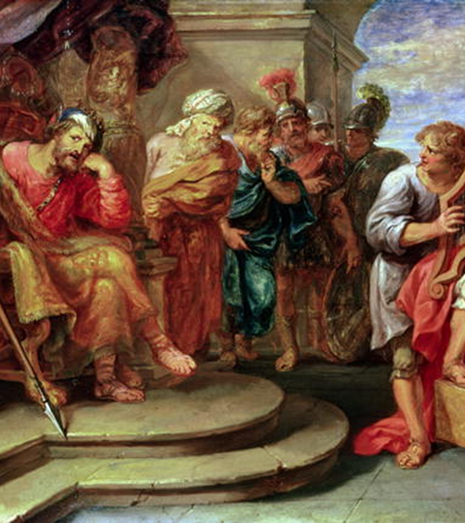
David’s Wisdom.
Most of us can trace all of our relational frustration to one source. SELF!

Slide 16
Saul’s Suspicion.
David is a type of who? Christ.
Notice the picture of WORSHIP!
Psalms 5:11 But let all those that put their trust in thee rejoice: let them ever shout for joy, because thou defendest them: let them also that love thy name be joyful in thee.

Slide 17
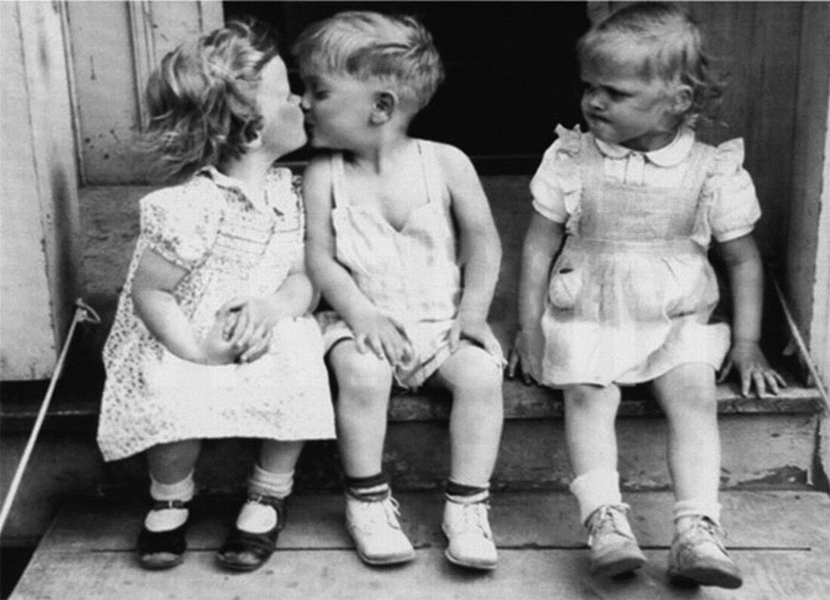
Pride.
Jealousy results you viewing your brother as your enemy.
Saul’s envy VS Paul’s humility.

Slide 18
1 Corinthians 4:6-15 And these things, brethren, I have in a figure transferred to myself and to Apollos for your sakes; that ye might learn in us not to think of men above that which is written, that no one of you be puffed up for one against another. 7 For who maketh thee to differ from another? and what hast thou that thou didst not receive? now if thou didst receive it, why dost thou glory, as if thou hadst not received it?

Slide 19
10 We are fools for Christ's sake, but ye are wise in Christ; we are weak, but ye are strong; ye are honourable, but we are despised. 11 Even unto this present hour we both hunger, and thirst, and are naked, and are buffeted, and have no certain dwellingplace; 12 And labour, working with our own hands: being reviled, we bless; being persecuted, we suffer it: 13 Being defamed, we intreat: we are made as the filth of the world, and are the offscouring of all things unto this day. 14 I write not these things to shame you, but as my beloved sons I warn you. 15 For though ye have ten thousand instructors in Christ, yet have ye not many fathers: for in Christ Jesus I have begotten you through the gospel.

Slide 20
John 1:26-27 John answered them, saying, I baptize with water: but there standeth one among you, whom ye know not; 27 He it is, who coming after me is preferred before me, whose shoe's latchet I am not worthy to unloose.
John 3:30 He must increase, but I must decrease.

Slide 21
1 Samuel 15:28 And Samuel said unto him, The LORD hath rent the kingdom of Israel from thee this day, and hath given it to a neighbour of thine, that is better than thou.

Slide 22
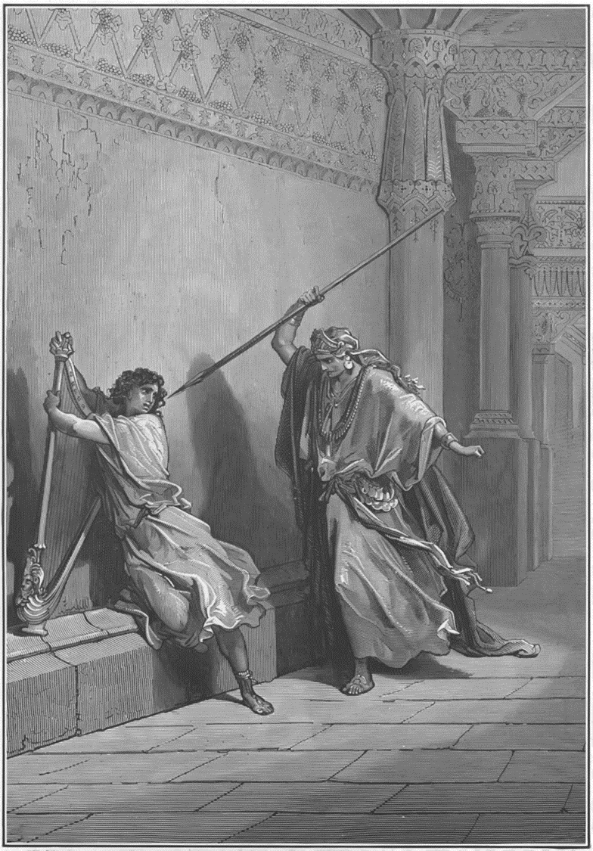
David’s Persecution.
One is leading in worship. The other is working out a murder.
Victory is always followed by attack.
Everyone has a Saul and Jonathan in their life.
You are either one or the other in the lives of others.

